Slide 1
Smart Manufacturing
In-Process Data Mining for Powder-Bed Fusion Additive Manufacturing
Problem #2
Zhibo Zhang (Team Leader)
Shubhendu Kumar Singh & Chandan Kumar Sahu
University at Buffalo

Slide 2
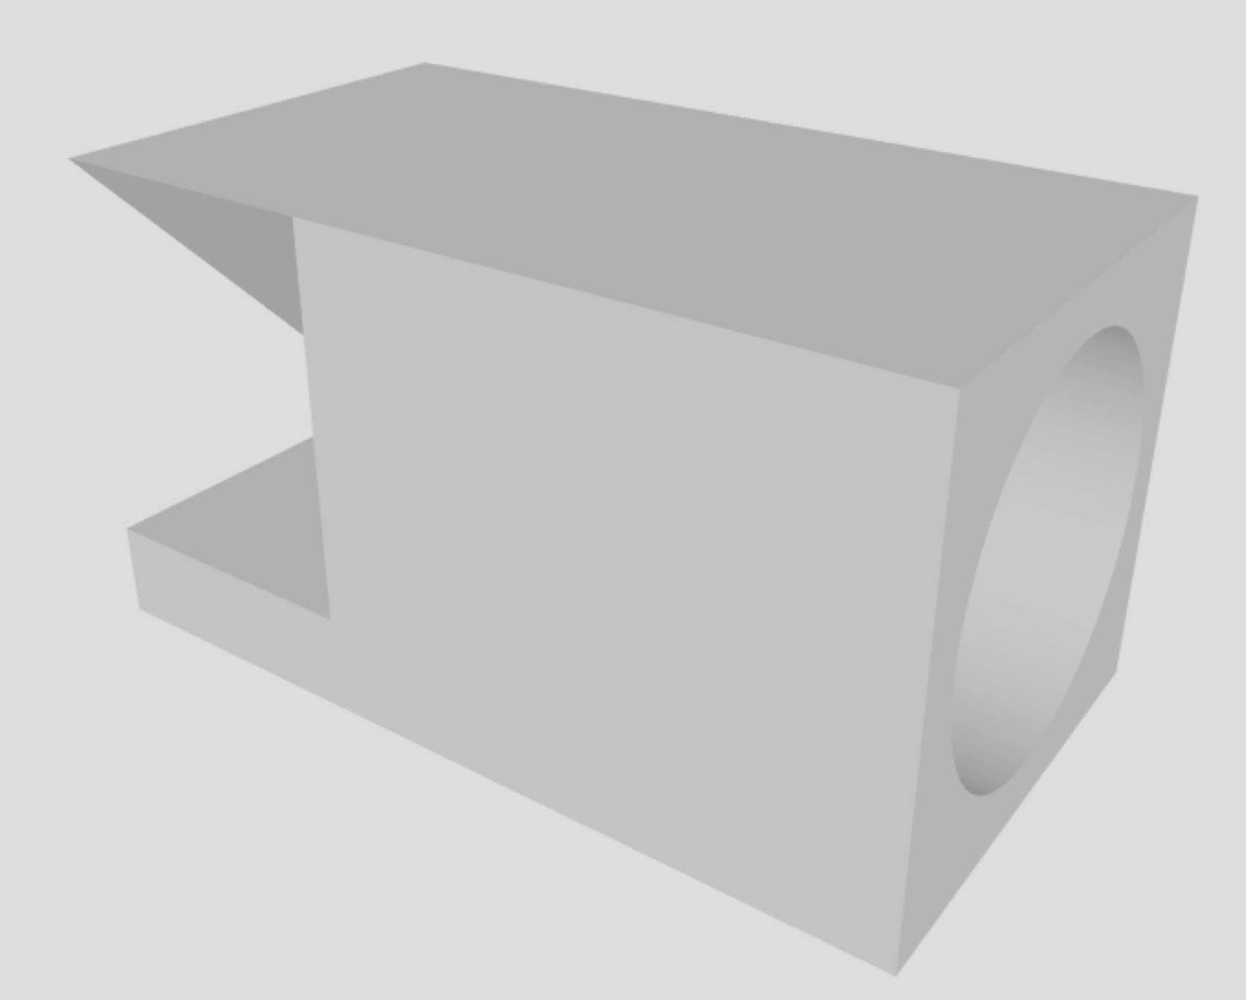
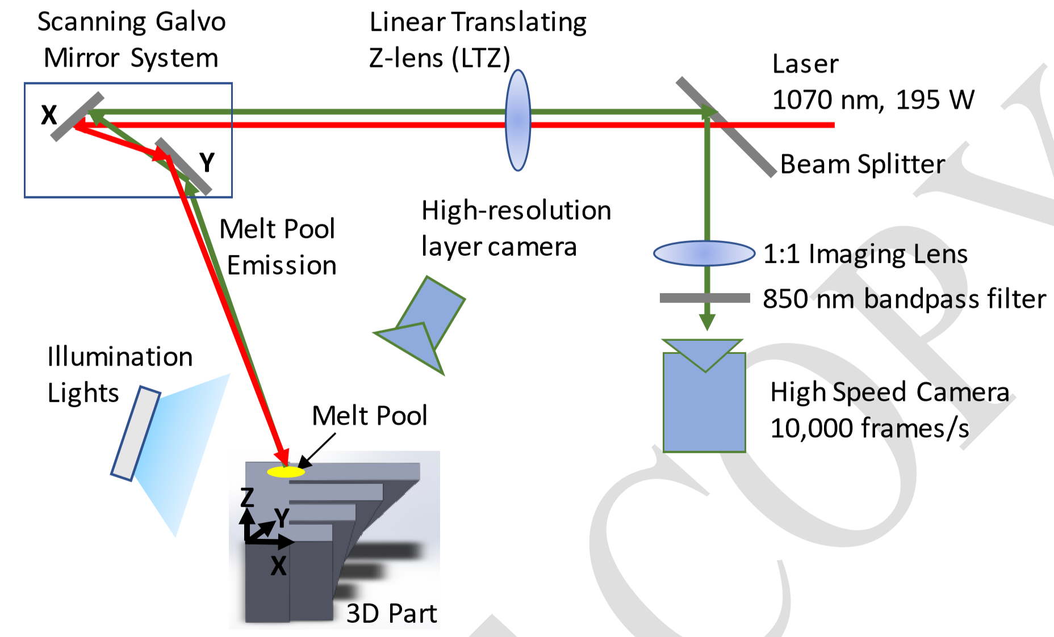
System Overview
Part Geometry
Experimental Setup for data collection

Slide 3
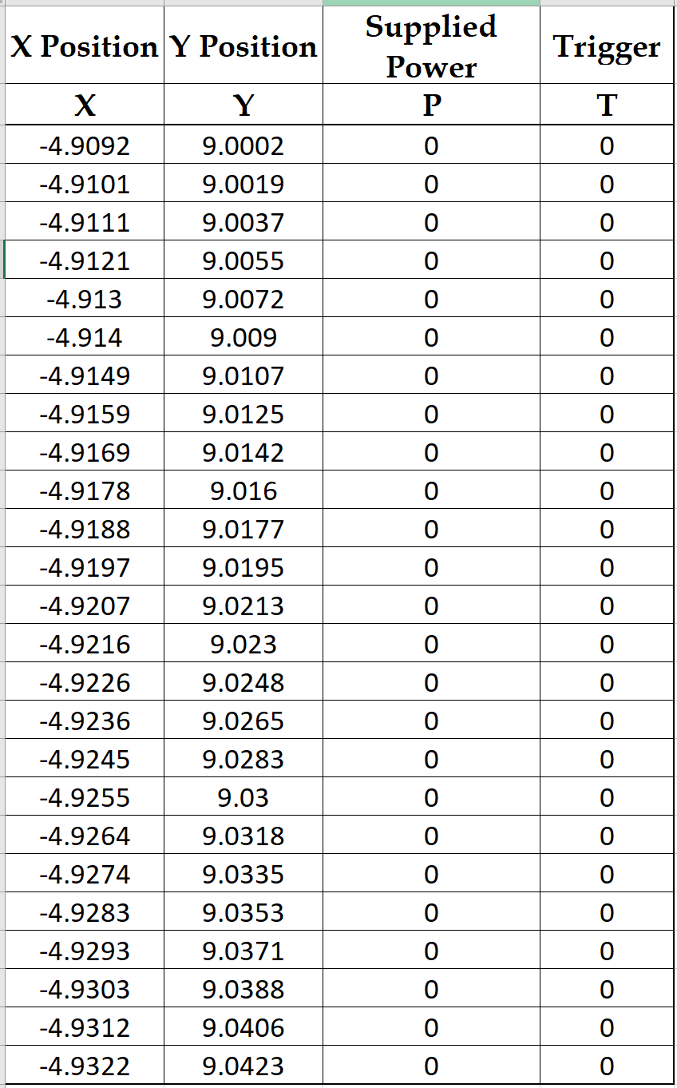
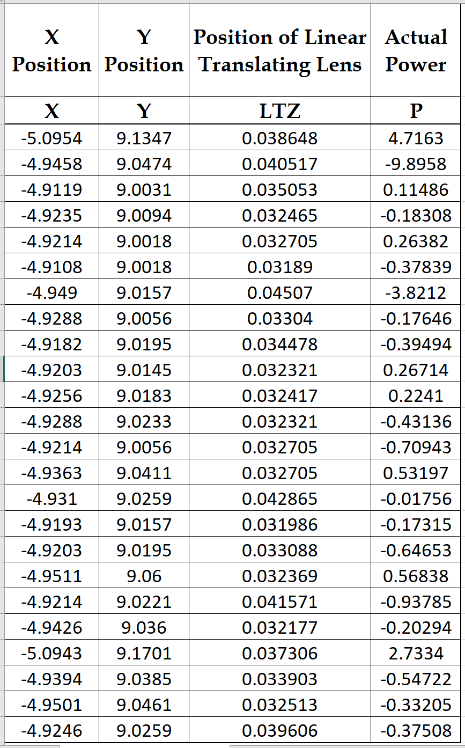
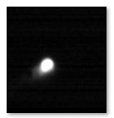
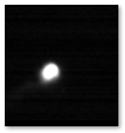
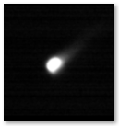
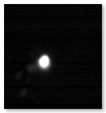
Attributes of the Dataset
Part geometry
XYPT commands for process control
DAQ data for real-time monitoring
Pertinent Metadata
Melt-pool images
Layerwise sets of images after and before burning
XCT data
Build Commands (XYPT)
DAQ Data
Melt-pool images

Slide 4
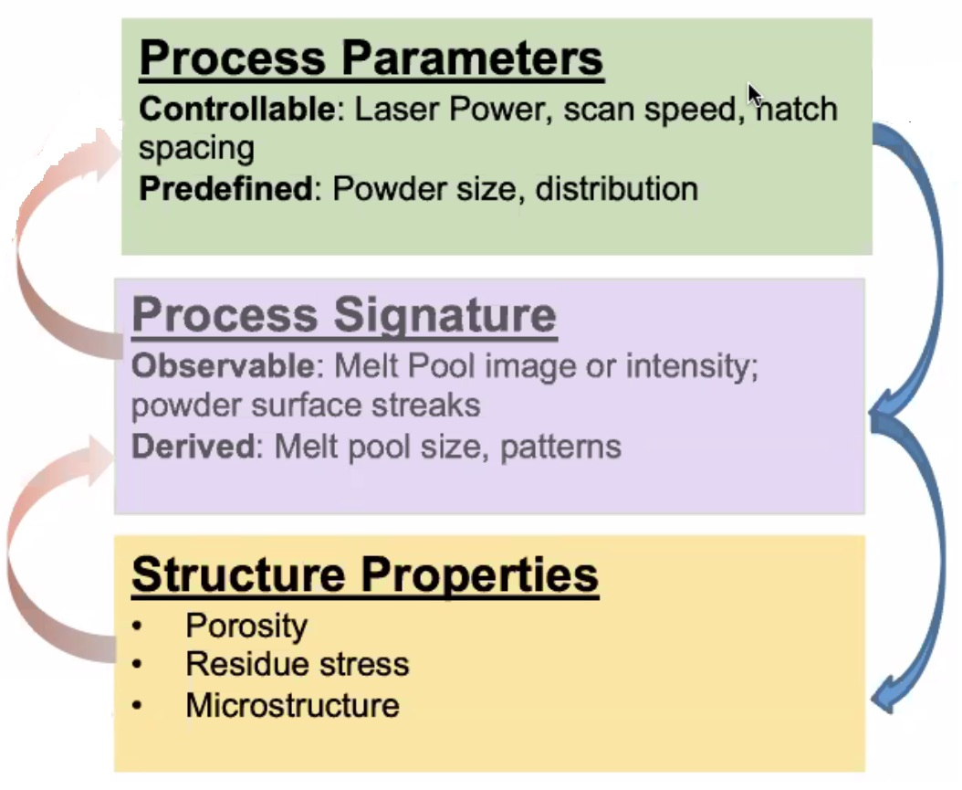
Capability of the dataset
Intended XY coordinates (XYPT)
Actual XY coordinates (DAQ)
Supplied Power (XYPT)
Actual power (DAQ)
Melt-pool images
Size of melt pool
(Qualitaive / Quantitaive)
Actual power
Process uncertainty
Melt pool image

Slide 5
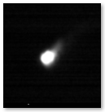
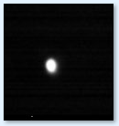
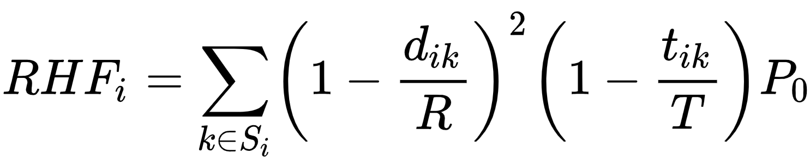
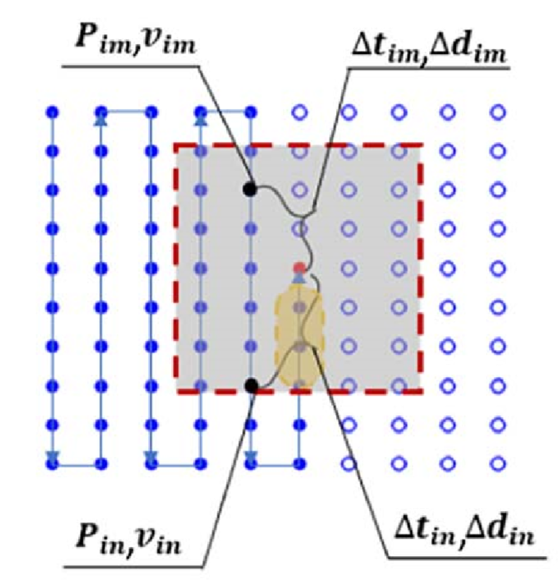
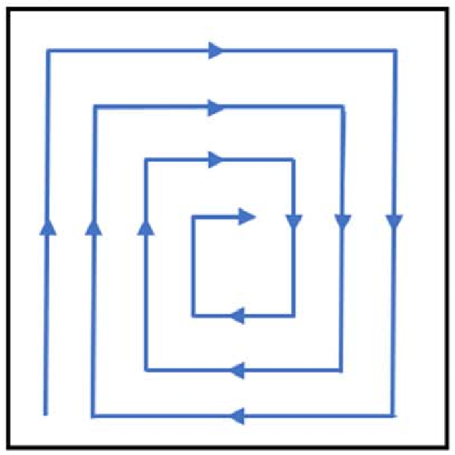
High Level Features
Velocity
Residual Heat Factor
Geometric Conductance factor
Over-melt with tail
Normal melt-pool
Serpentine Scan Strategy
Spiral Centering Pattern

Slide 6
Thrust 1 : Prediction of melt pool size
Motivation
Better process stability
Avoid porosity and minimize surface defects
Affecting Factors
Primary process parameters : hatch pattern, power, velocity, neighborhood parameters [1]
Secondary factors : Residual Heat Factor [2]
Ground Truth Data Collection
Pixel Thresholding
[1] A meltpool prediction based scan strategy for powder bed fusion additive manufacturing
[2] A Residual Heat Compensation Based Scan Strategy for Powder Bed Fusion Additive Manufacturing
Notes:
Past work - polynomial regression

Slide 7
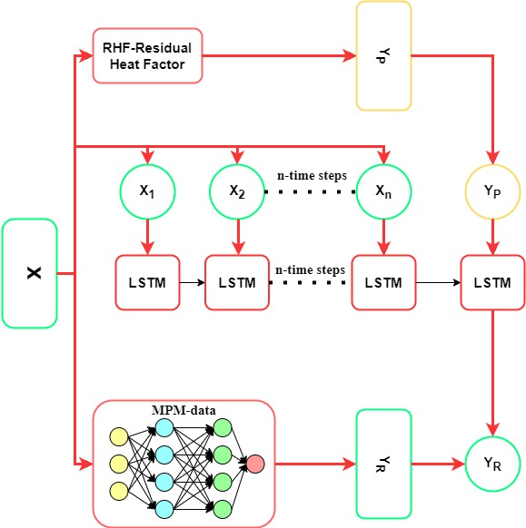
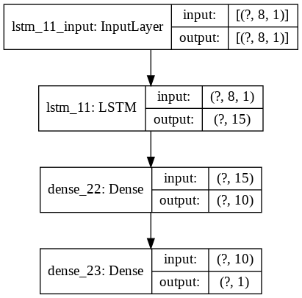
Thrust 1 : Melt pool Prediction -Model Architecture
Notes:
Past work - polynomial regression

Slide 8
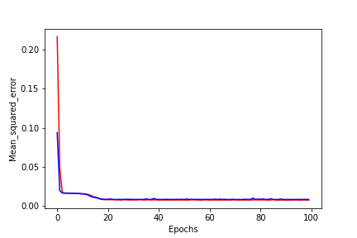
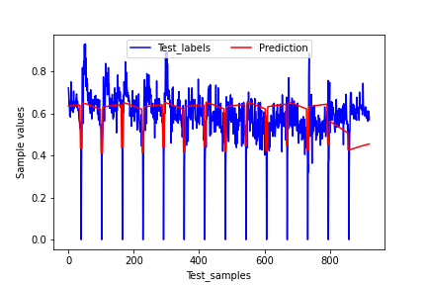
Thrust 1 : Results
Notes:
Past work - polynomial regression

Slide 9
Thrust 1 : Analysis
Total Trainable Parameters- 1191
Test Error- 0.0127
Size prediction-enables process stability
Negates dependence on sensor-based monitoring
Notes:
Past work - polynomial regression

Slide 10
Thrust 2 : Direct prediction of the meltpool
Motivation
Eliminate high speed sensors
Continuous image generation
Factors : Laser position, Power, Velocity
Over-melt with tail
Normal melt-pool

Slide 11
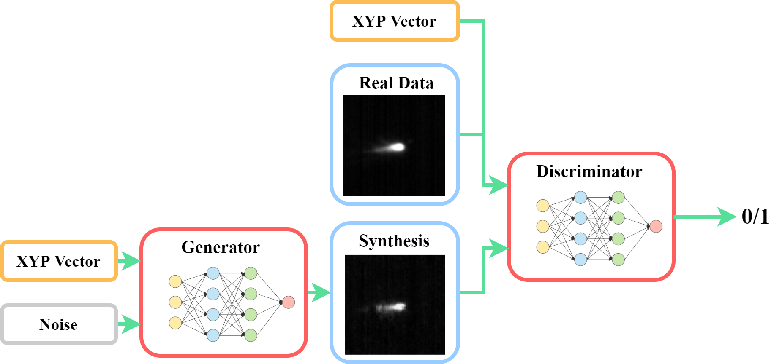
Thrust 2 : Direct prediction of the meltpool
Generator:
Dense(6400)
Upsampling
Conv(64)
Upsampling
Conv(32)
Upsampling
Conv(16)
Discriminator:
Conv(32)
Conv(64)
Conv(128)
Flatten()
MPM-GAN
LR: 0.0002
Latent_vector: 500
Optimizer: Adam
Batch Size: 128

Slide 12
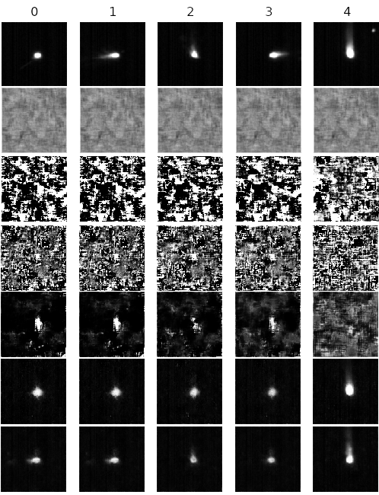
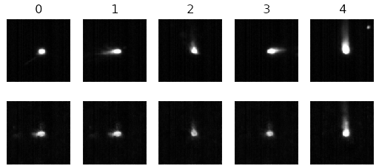
Thrust 2 : Direct prediction of the meltpool
Testing MAE = 6.2449054 (1000 images as test set, range = [0, 255]
Epoch

Slide 13
Future Work
With this dataset
Estimating actual power requirement using RHF, melt-pool
Process signature → Structural properties
using XCT data
Layerwise images
Expanding the dataset
Real-time temperature information

Slide 14
Challenges Addressed
Broader Impact
Feature extraction
Relationship between build commands and coaxial melt pool characteristics
Multi-modal data association
Expansion into other AM processes
Construction of digital twins

